Slide 1

C++
Group-12

Slide 2

Introduction
This presentation explains a simple login system implemented in C++. It covers the core features such as user registration, login process, and password hashing. The goal is to create a secure, easy-to-use system with data stored in a plain text file. Visual aids like login form illustrations enhance understanding.
C++
Group-12

Slide 3

01
Introduction to Login System

Slide 4
Purpose and Features
The system enables users to register and log in securely by storing hashed passwords. Key features include simple user management, password hashing to protect credentials, and data storage in a text file named users.txt. This approach balances ease of implementation and basic security needs.

Slide 5
User Registration Process
Users provide a username and password during registration. The password is hashed using a custom function before saving, ensuring it’s not stored in plaintext. Each entry is recorded in users.txt. This process guarantees that sensitive data is handled securely from the start of user interaction.

Slide 6
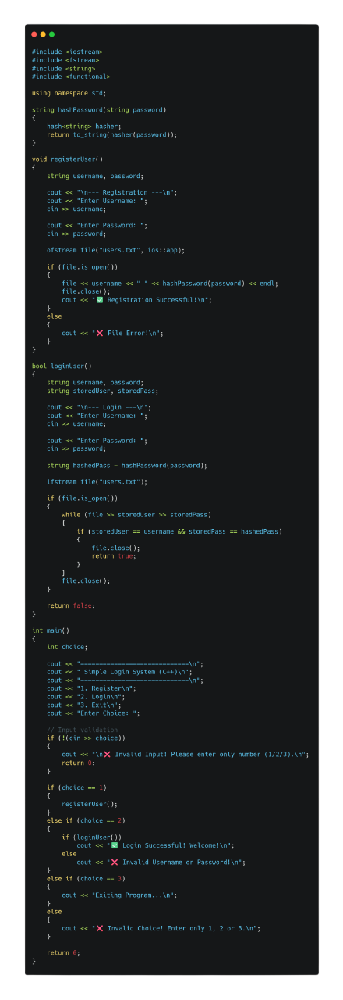
02
Code Implementation

Slide 7
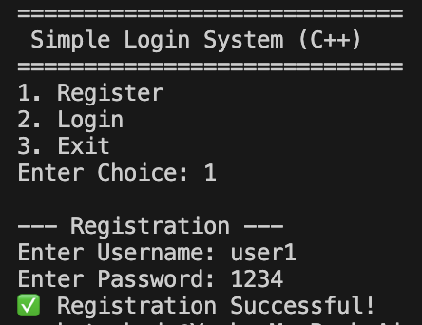
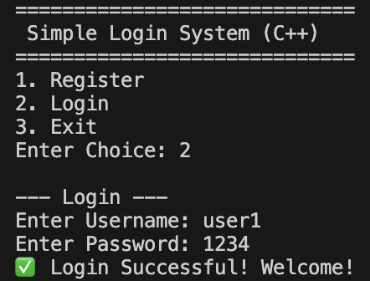
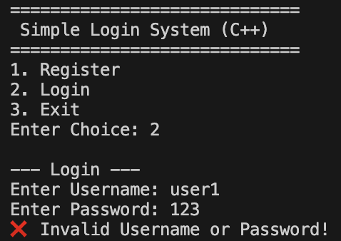
Output
Register
Login
If user or password invalid

Slide 8
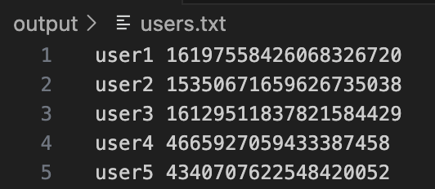
Output
Local User Data Storage (user.txt)
User data is stored locally in a text file named The file is created in the program output directory
C++ file handling (is used to store and read data
Each line represents one registered user
Data format used:
Passwords are hashed, not stored in plain text
Improves basic data security
Suitable for offline and small-scale login systems
No database or internet connection required

Slide 9
Conclusions
This system demonstrates a fundamental and secure user login process utilizing password hashing. Although basic, it effectively protects user data stored in plain text files. Future improvements could include adopting stronger hash algorithms and integrating database storage for enhanced scalability and security.
Thanks

Slide 10
Thanks

